Slide 1
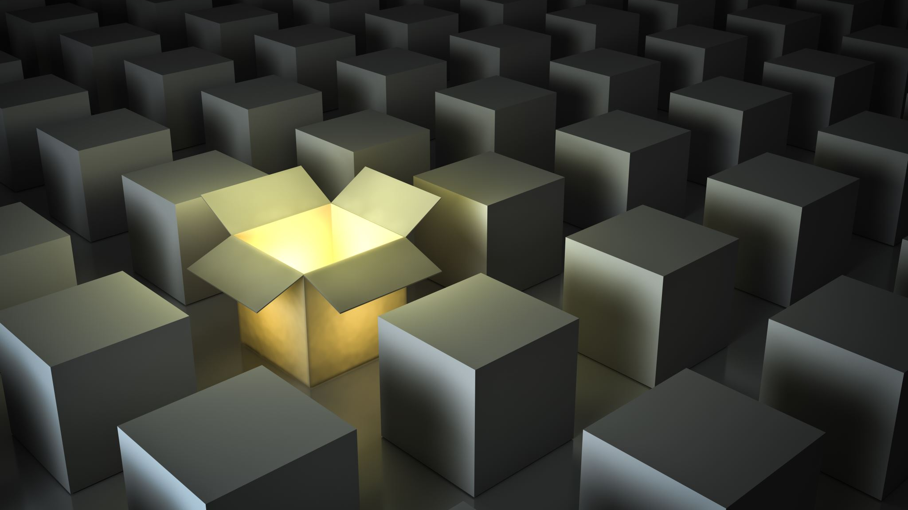
The Block Puzzle
Why Do Colliding Block Compute PI?

Slide 2
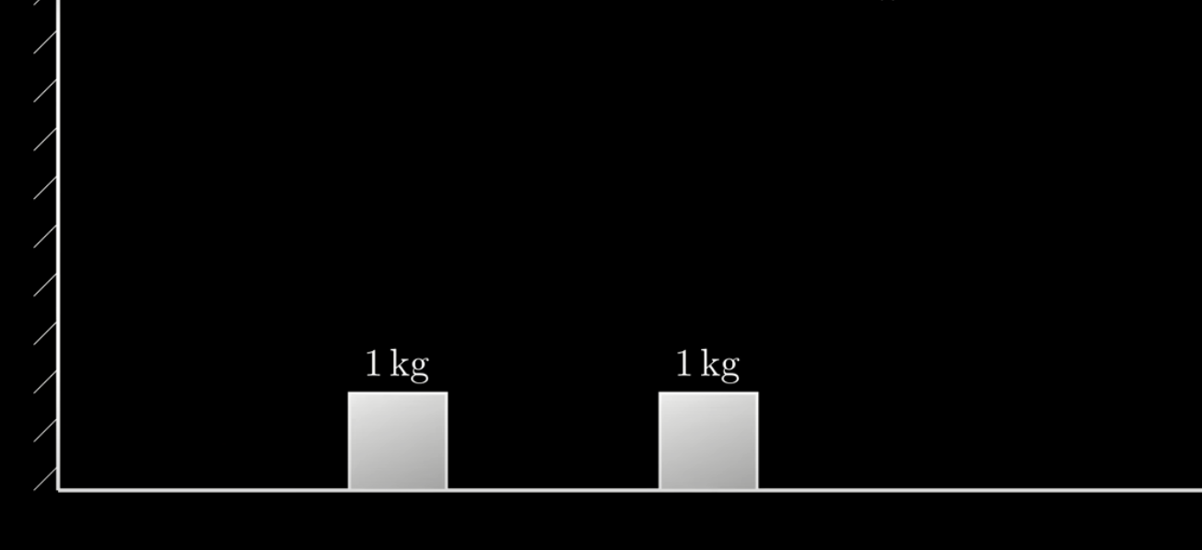
Let’s Imaging a 2D plane, where there is no Friction. On the left side is a wall. There are 2 blocks on the plane. Let the block on the right be “B” and on the left “A”.

Slide 3
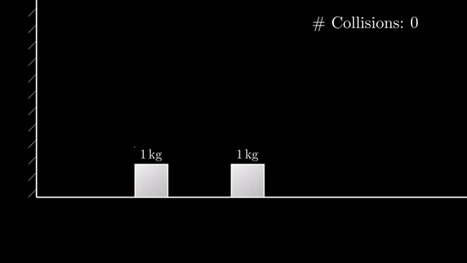
Let “B” have a constant velocity >0, it moves and hits box A, next A hits the wall and reflects, and hits B for the last time.
There were 3 collisions.

Slide 4
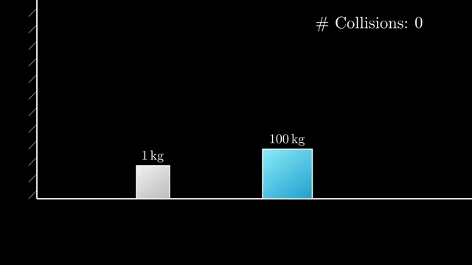
Let’s do the same thing, but this time with A=1kg and B=100kg
This time it was 31 collisions.

Slide 5
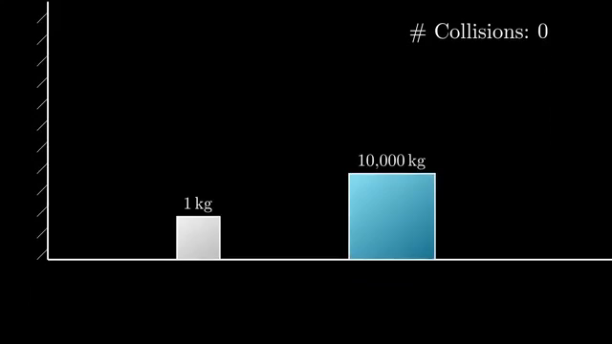
Let’s go it again with
B= 10,000 kg
We notice that this time there were 314 collisions.

Slide 6
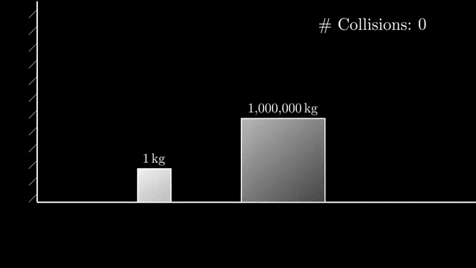
And this time with B is 1,000,000
And this time there were 3141 collisions.
All this is random, or is it?

Slide 7
So why Did just tell you a bunch of numbers?
Well if you noticed carefully, all the collisions were digits of PI.
PI= 3.141592.....
So if the mass of B was some power of hundred times the mass of Box A then the resulting collisions were digits of PI. To keep it simple let Box A always be 1kg.
BOX B mass:
100^0 = 1kg ( 3 collisions)
100^1= 100 ( 31 collisions)
100^2= 10,000 ( 314 collisions)
100^3= 1,000,000 ( 3141 collisions)
And So on...
This may look like it coincidental but this has a much bigger reason...

Slide 8
To understand all that, First we need to compute the velocity of both Boxes, and every time after they collide.
To find the Velocity we first need to know two Laws,
Conservation of Energy.
Conservation of Momentum.

Slide 9
Let’s name some Variables.
Box B (the Big one):
mass= m1
v = v1
Box A (the Small one):
mass= m2
v = v2

Slide 10
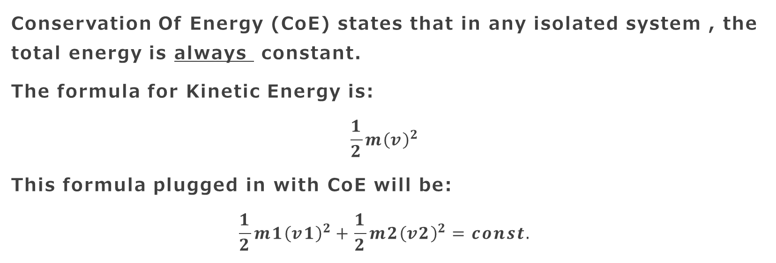
Conservation Of Energy.
Conservation Of Energy (CoE) states that in any isolated system , the total energy is always constant.
The formula for Kinetic Energy is:
$$\frac{1}{2}m{\left(v\right)}^{2}$$
This formula plugged in with CoE will be:
$$\frac{1}{2}m1{\left(v1\right)}^{2}+\frac{1}{2}m2{\left(v2\right)}^{2}=const.$$

Slide 11
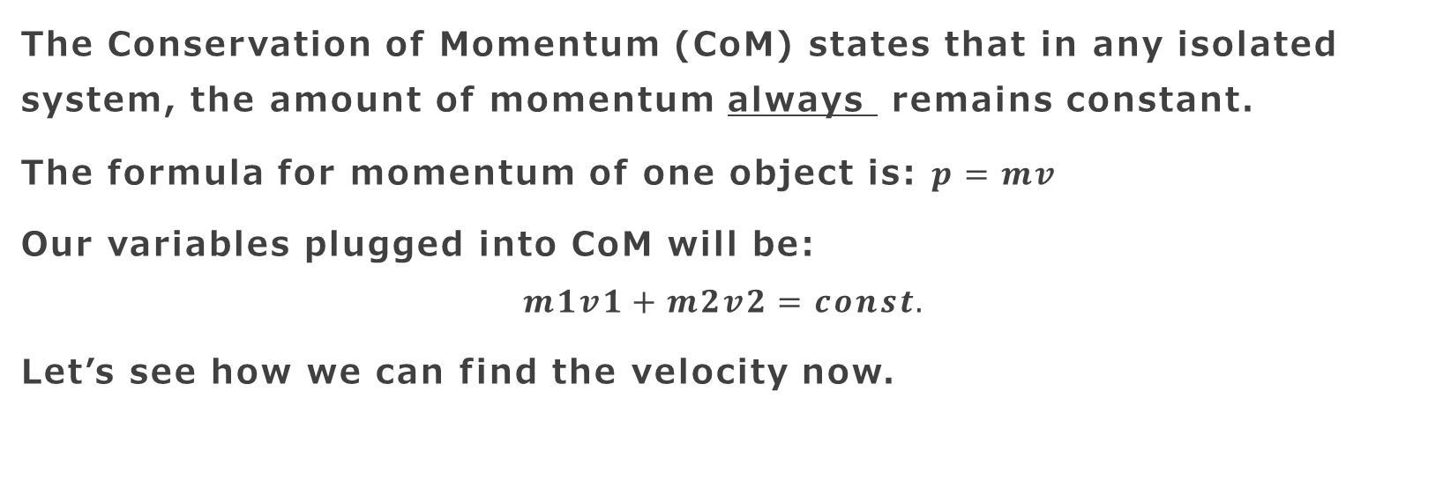
Conservation of Momentum
The Conservation of Momentum (CoM) states that in any isolated system, the amount of momentum always remains constant.
The formula for momentum of one object is: $p=mv$
Our variables plugged into CoM will be:
$$m1v1+m2v2=const.$$
Let’s see how we can find the velocity now.

Slide 12
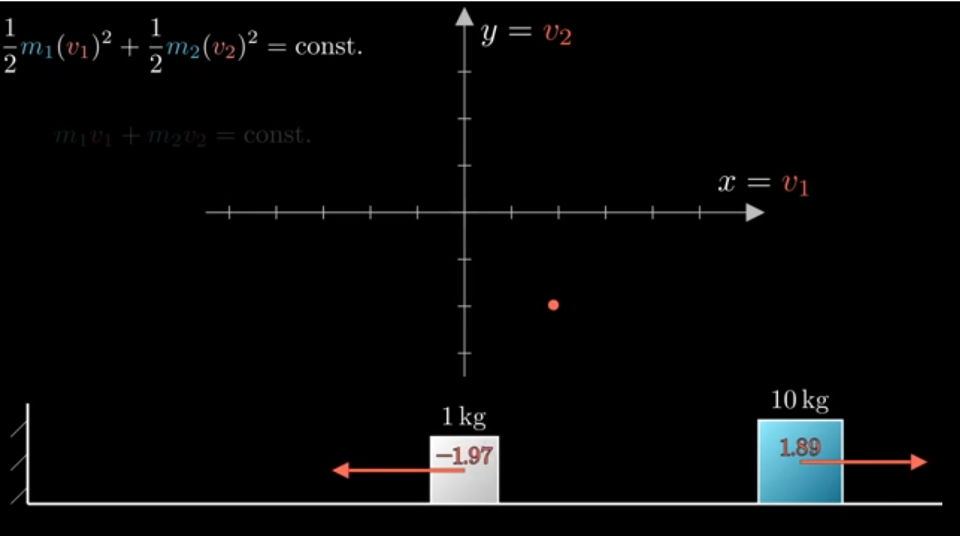
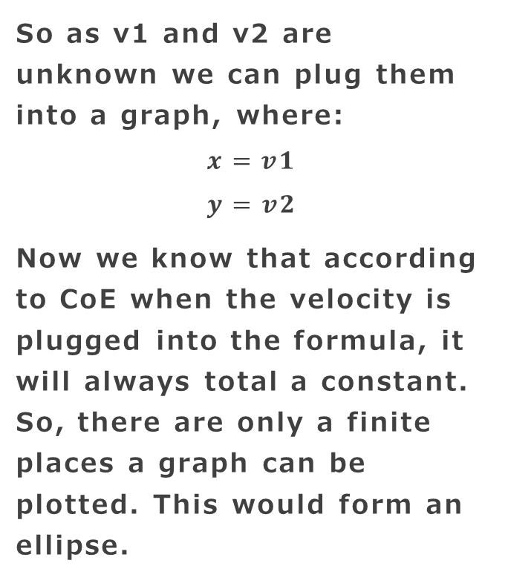
So as v1 and v2 are unknown we can plug them into a graph, where:
$$x=v1$$
$$y=v2$$
Now we know that according to CoE when the velocity is plugged into the formula, it will always total a constant. So, there are only a finite places a graph can be plotted. This would form an ellipse.

Slide 13
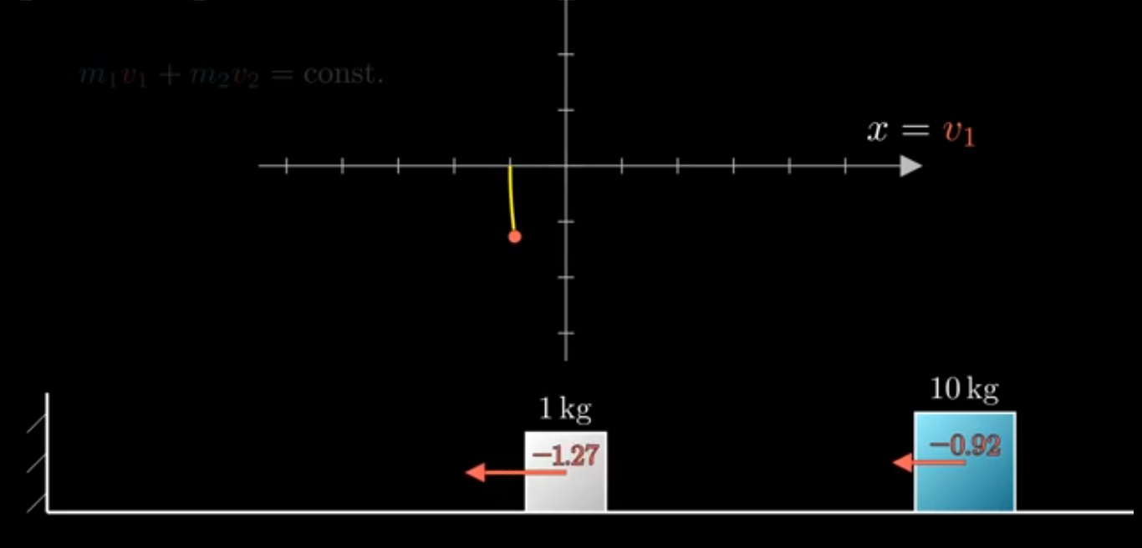
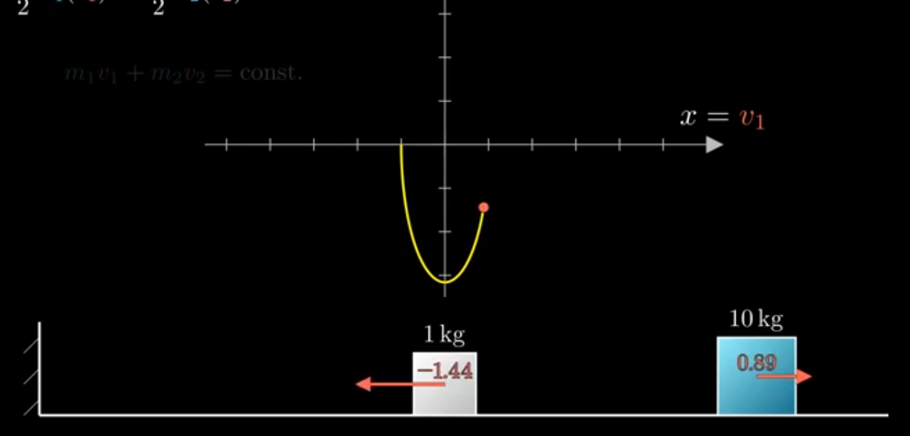
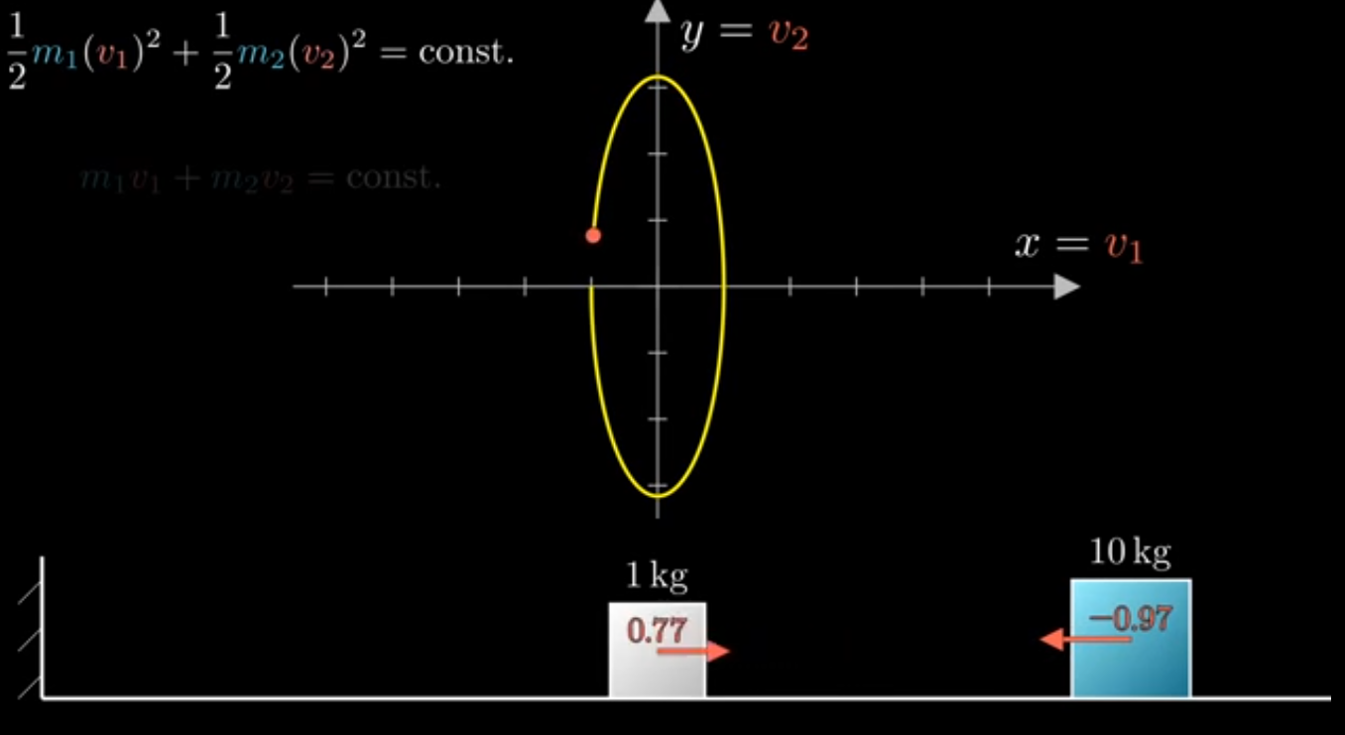
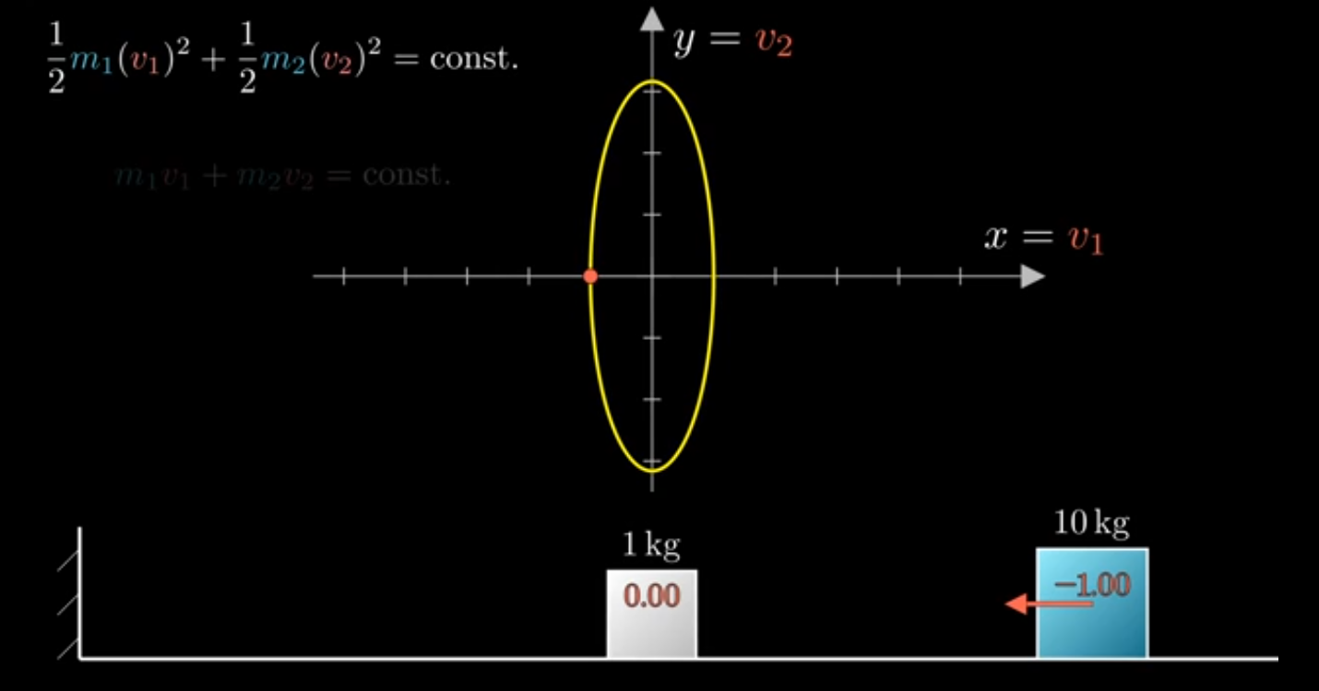

Slide 14
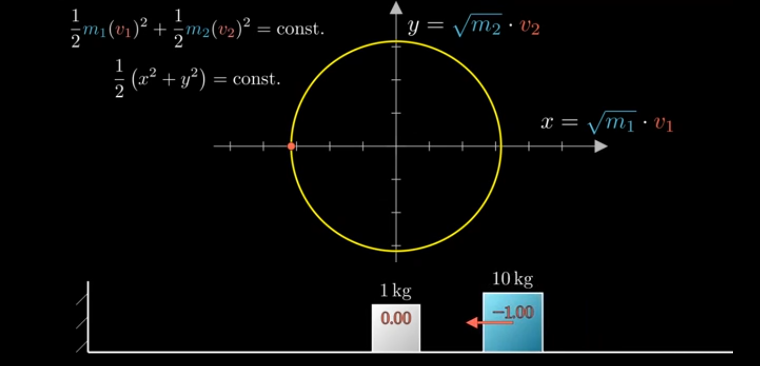
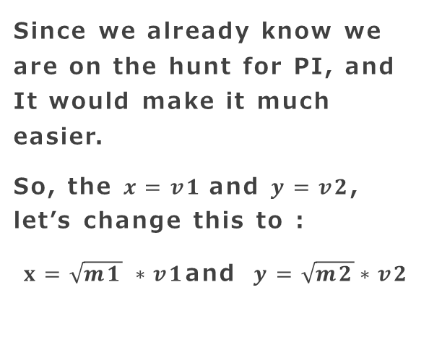
Why Not Turn this Ellipse to a circle?
Since we already know we are on the hunt for PI, and It would make it much easier.
So, the $x=v1$and $y=v2$, let’s change this to :
$x=\sqrt{m1} ∗v1$and $y=\sqrt{m2}∗v2$

Slide 15
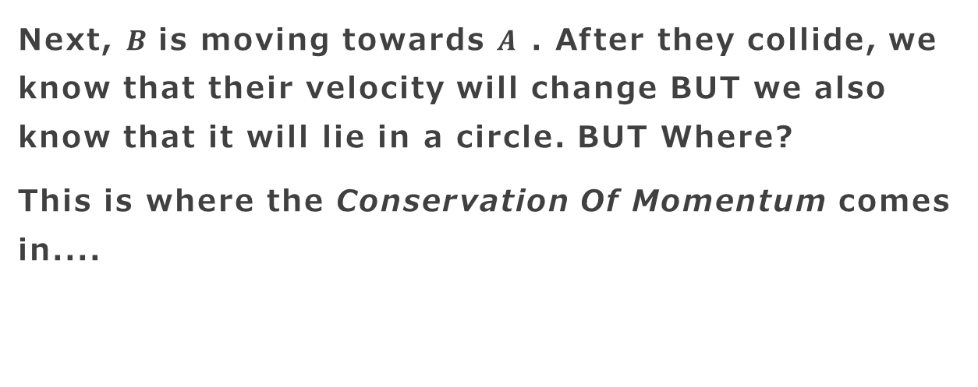
What next?
Next, $B$is moving towards $A$ . After they collide, we know that their velocity will change BUT we also know that it will lie in a circle. BUT Where?
This is where the Conservation Of Momentum comes in....

Slide 16
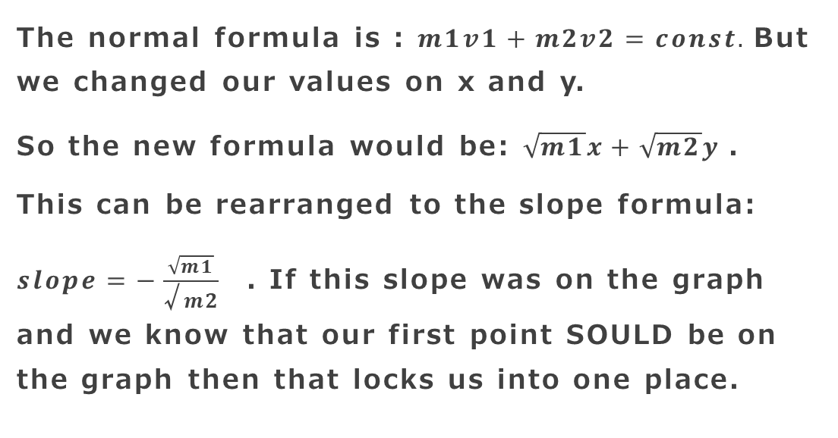
How do we use it?
The normal formula is : $m1v1+m2v2=const.$But we changed our values on x and y.
So the new formula would be: $\sqrt{m1}x+\sqrt{m2}y$.
This can be rearranged to the slope formula: $slope=−\frac{\sqrt{m1}}{\text{√}m2}$ . If this slope was on the graph and we know that our first point SOULD be on the graph then that locks us into one place.

Slide 17
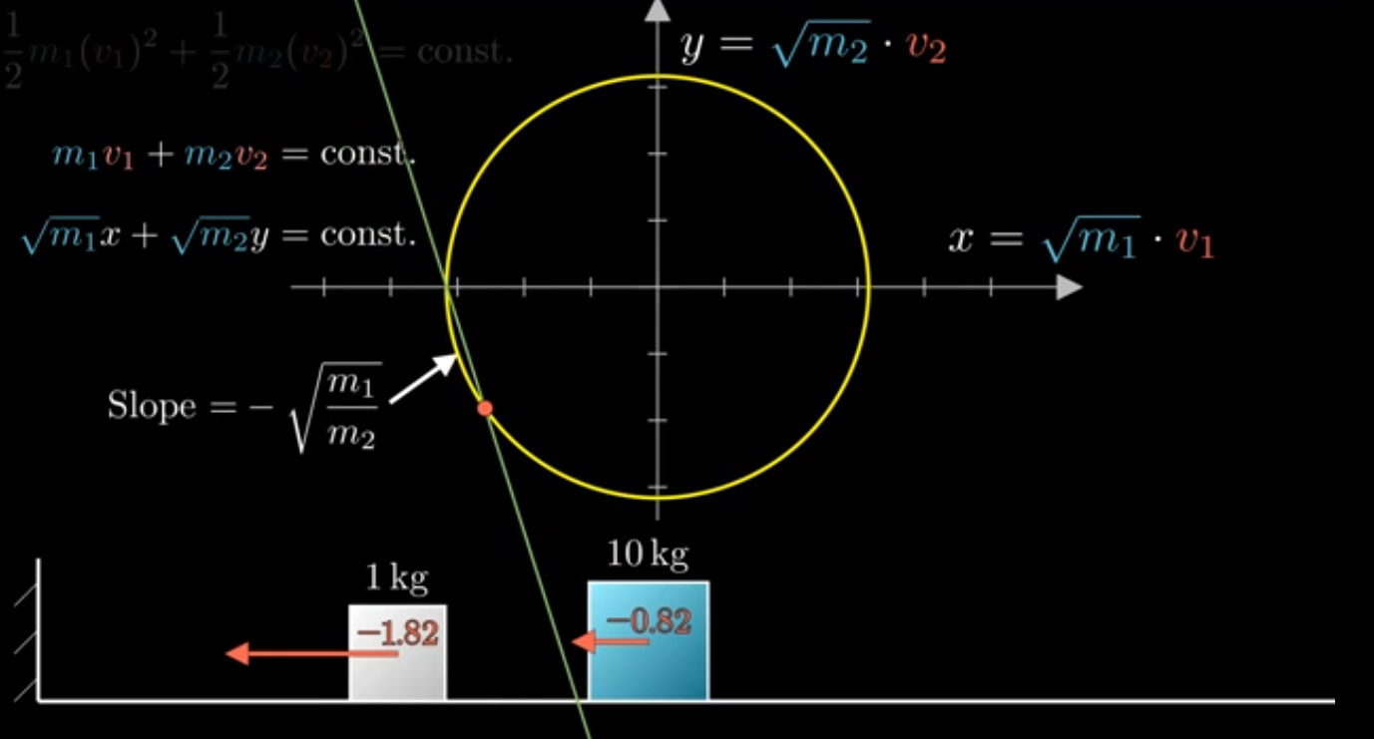

Slide 18
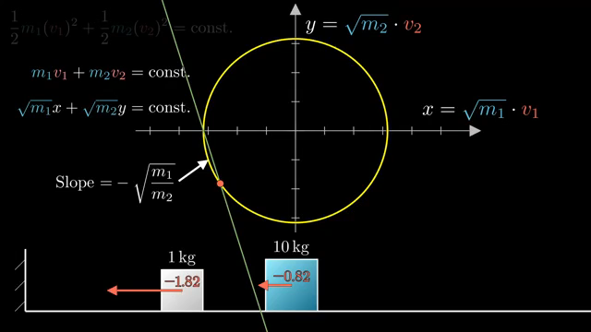
Now A will hit the wall, where do you think the next point will be?

Slide 19
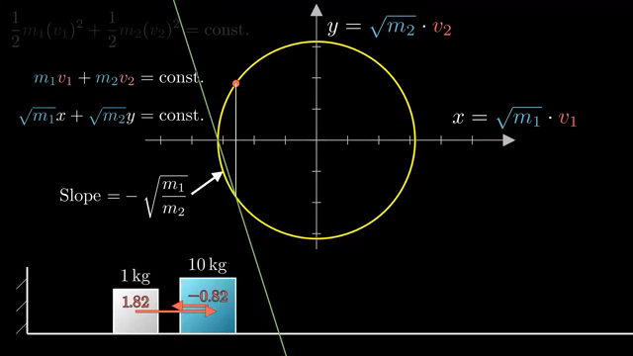
Well, next A will hit B. What will be the new velocity?

Slide 20
What about the other collisions?
So as the first point moved using the Slope formula and then after hitting the wall the Y-axis is inverted and then Again the Slope formula we used will move to the 3dh point and this will give us our 4h point. This will keep on going , but when does it stop? When the value of A will be positive AND less than B . We can shade an area where the previous condition is true on the graph.

Slide 21
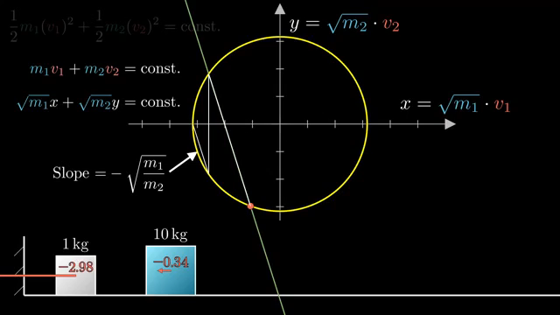

Slide 22
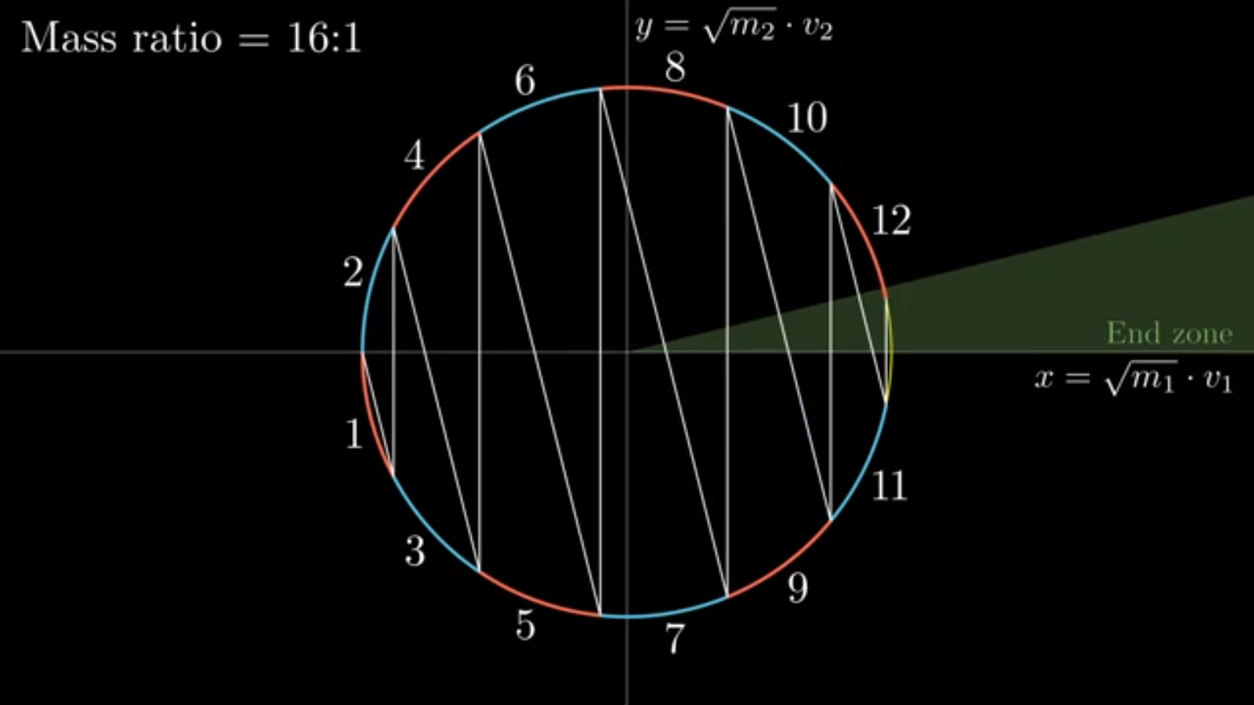
If you noticed carefully then all the arc lengths after tracing the collisions on the graph are equal.
So, if we calculate the size of one arc length, we should be able to calculate the number of collisions it takes to reach the end zone.
How do we calculate the length?

Slide 23
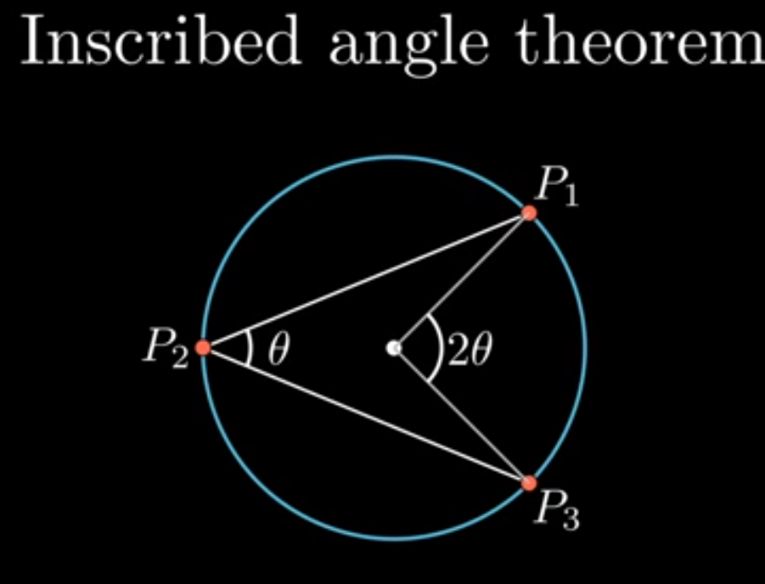
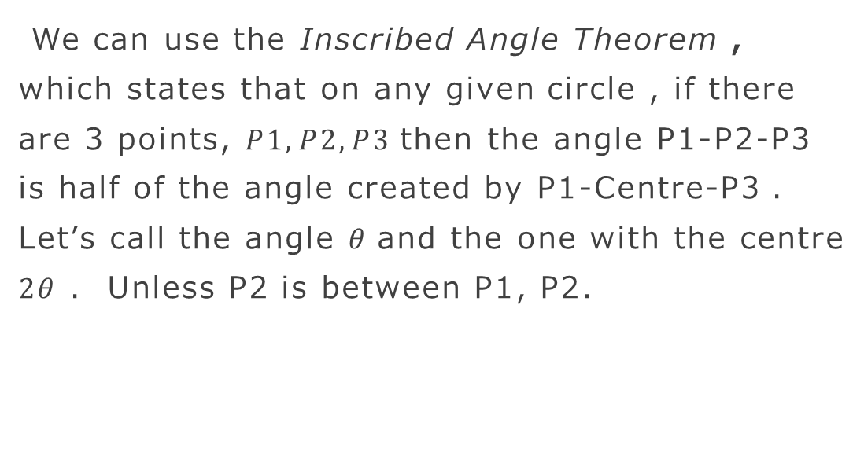
Inscribed Angle Theorem
We can use the Inscribed Angle Theorem , which states that on any given circle , if there are 3 points, $P1, P2, P3$then the angle P1-P2-P3 is half of the angle created by P1-Centre-P3 . Let’s call the angle $θ$and the one with the centre $2θ$ . Unless P2 is between P1, P2.

Slide 24
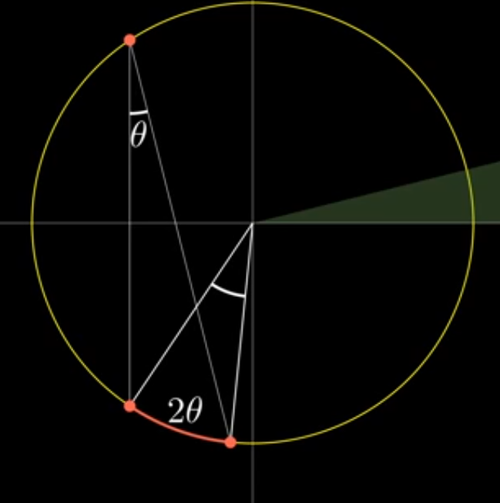
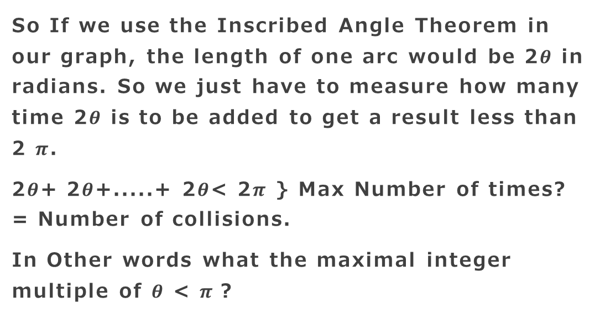
So If we use the Inscribed Angle Theorem in our graph, the length of one arc would be 2$θ$ in radians. So we just have to measure how many time 2$θ$ is to be added to get a result less than 2 $π$.
2$θ$+ 2$θ$+.....+ 2$θ$< 2$π$ } Max Number of times? = Number of collisions.
In Other words what the maximal integer multiple of $θ$ < $π$?

Slide 25
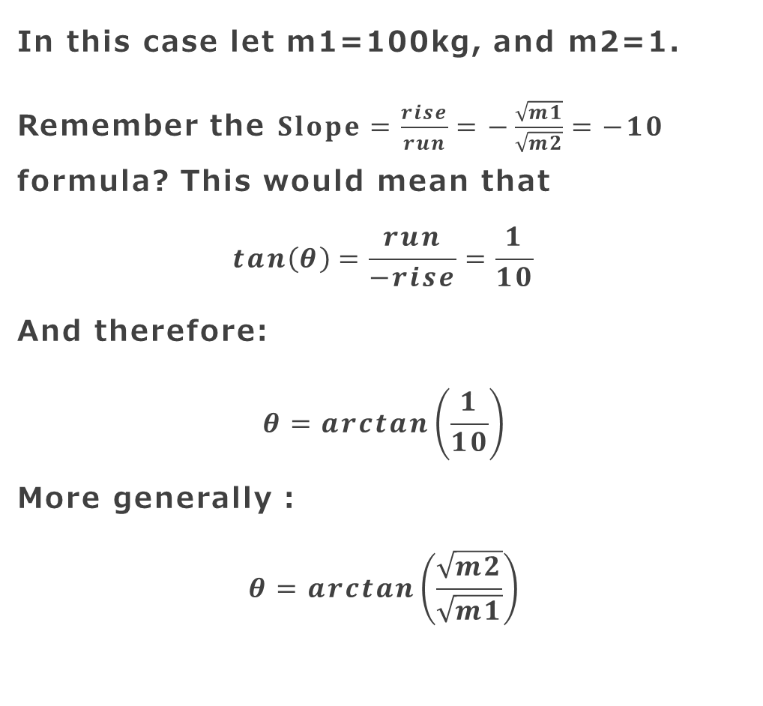

Let’s Compute $θ$
In this case let m1=100kg, and m2=1.
Remember the $Slope=\frac{rise}{run}=−\frac{\sqrt{m1}}{\sqrt{m2}}=−10$ formula? This would mean that
$$tan\left(θ\right)=\frac{run}{−rise}=\frac{1}{10}$$
And therefore:
$$θ=arctan\left(\frac{1}{10}\right)$$
More generally :
$$θ=arctan\left(\frac{\sqrt{m2}}{\sqrt{m1}}\right)$$

Slide 26
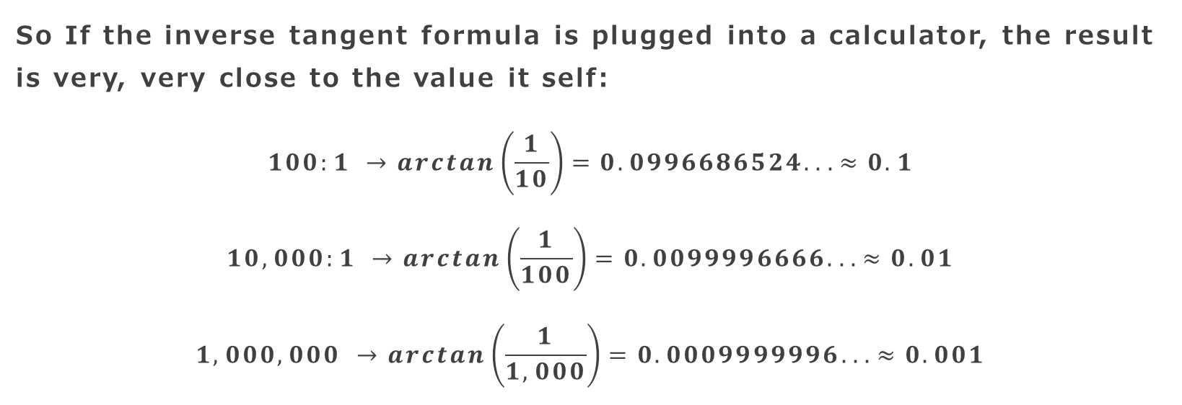
Result of Arctan?
So If the inverse tangent formula is plugged into a calculator, the result is very, very close to the value it self:
$$100:1 →arctan\left(\frac{1}{10}\right)=0.0996686524. . .≈0.1$$
$$10,000:1 →arctan\left(\frac{1}{100}\right)=0.0099996666. . .≈0.01$$
$$1,000,000 →arctan\left(\frac{1}{1,000}\right)=0.0009999996. . .≈0.001$$

Slide 27
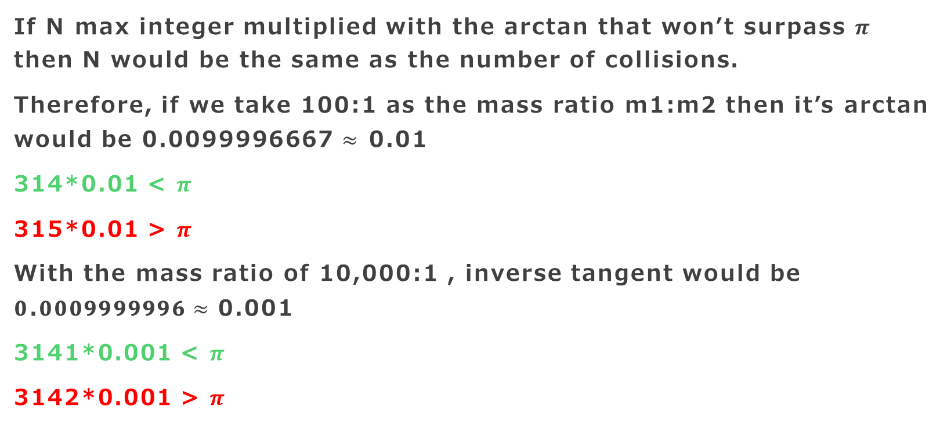
This is why the number of collisions are digits of PI.
If N max integer multiplied with the arctan that won’t surpass $π$ then N would be the same as the number of collisions.
Therefore, if we take 100:1 as the mass ratio m1:m2 then it’s arctan would be 0.0099996667 $≈$ 0.01
314*0.01 < $π$
315*0.01 > $π$
With the mass ratio of 10,000:1 , inverse tangent would be 𝟎.𝟎𝟎𝟎𝟗𝟗𝟗𝟗𝟗𝟗𝟔$≈$ 0.001
3141*0.001 < $π$
3142*0.001 > $π$

Slide 28
Sources:
This question and answer was found on 3Blue1Brown
The video with the Question and Answer .
The video clips and pictures in this presentation belong to 3Blue1Brown and I do not own them.

Slide 29
Thank You,
~Hriday Barot

